Slide 1



s
Computer Engineering
Mini Project Final-Presentation
SEM - VI
2021-22

Slide 2
X-Ray Report Prediction

Slide 3
Team Members
👦 Gautam Sathe- TEB231
👦 Aniket Singh- TEB240
👦 Shivendra Singh-TEB242
👦 Kovid Thalia-TEB244
Supervisor:
Prof. Sanjivani Deokar

Slide 4
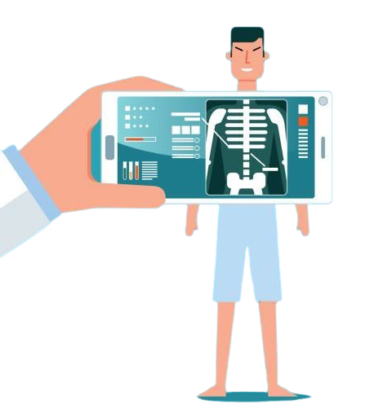
Outline
Introduction
Motivation
Objectives
Literature Survey
Existing System
Proposed System
Design Of The System
Software
And Hardware Requirements
Results
Conclusion
Future Work
Reference

Slide 5

Introduction
As the project name suggest idea is basically based on the mixture of Bioinformatics and Deep learning concept.
Project interface will ask for the user input in the form of X-ray report and give the outcome as Disease positive and negative.
Also making user friendly interface for which Flask based web application will be created

Slide 6
Motivation
Coronavirus disease (COVID-19) a relatively new found virus has caused a pandemic all over the world. For the last 2 year we have suffered and witnessed the effects of the virus. Almost all the sectors have been adversely affected as domestic demand and exports sharply plummeted with some notable exceptions where high growth was observed.
As the testing of coronavirus happened manually in the initial stage, the ever-increasing number of COVID-19 could not be handled manually efficiently.

Slide 7

Objectives
To handle the situation we have attempted to detect coronavirus or pneumonia using chest X-ray images and Chest CT scan images by using Artificial Intelligence technologies.
To predict the the coronavirus or pneumonia using the data collected from the testings.
Create a Training Model to check the probability/chances of X-ray report being positive and in that process to develop a Convolutional Neural Network (CNN) Model.
To save lives!

Slide 8
Literature Survey
2021 | COVID-19 Diagnosis using X-Ray Images and Deep learning | Shivani Sharma; Shamik Tiwari | India | In this paper, 3 models were developed. Namely CNN, VGG16 and VGG19 for multi classification of 3 classes (Covid-19, Pneumonia and Normal). Accuracy of the VGG16 and VGG19 was better (i.e 97%) than the CNN model(i.e 94%). But VGG16 and VGG19 uses more computational power where CNN model took less computational power in comparison to VGG16 and VGG19. | The proposed CNN model provides good accuracy on less number of layers and less number of epochs in comparison to pre-trained models.This CNN model is better than other models as it is less complex than others and achieving good accuracy on training, validation as well as on test dataset. CNN not only has less layers th
2021 | Automatic COVID-19 detection from X-ray images using ensemble learning with convolutional neural network | Amit Kumar Das, Sayantani Ghosh, Samiruddin Thunder, Rohit Dutta, Sachin Agarwal, Amlan Chakrabarti | India | In this paper, multiple CNN models—DenseNet201, Resnet50V2 and Inceptionv3, have been adopted in the proposed work. 538 images of COVID +ve patients and 468 images of COVID –ve patients have been divided into training, test and validation sets. The proposed approach gave a classification accuracy of 91.62% which is higher than the state-of-the-art CNN models. | The proposed model has achieved a classification accuracy of 91.62%. It yields a sensitivity of around 95% for COVID +ve cases i.e., out of 100 COVID +ve patients, more than 95 can be correctly diagnosed by the proposed model

Slide 9
2021 | Pneumonia detection in chest X-ray images using an ensemble of deep learning models | Rohit Kundu, Ritacheta Das, Zong Woo Geem, Gi-Tae Han, Ram Sarkar | India | In this study, they designed an ensemble of three convolutional neural network models: GoogLeNet, ResNet-18, and DenseNet-121. The proposed approach was evaluated on two publicly available pneumonia X-ray datasets using a five-fold cross-validation scheme. The proposed method achieved accuracy rates of 98.81% and 86.85% and sensitivity rates of 98.80% and 87.02% on the Kermany and RSNA datasets, respectively. | In some instances this ensemble framework failed to produce correct predictions.
2021 | COVID-19 detection in X-ray images using convolutional neural networks | Daniel Arias-Garzón, Jesús AlejandroAlzate-Grisales, Simon Orozco-Arias, Harold Brayan Arteaga-Arteaga, Mario Alejandro Bravo-Ortiz, Alejandro Mora-Rubio, Jose Manuel Saborit-Torres, Joaquim Ángel Montell Serrano, Maria de la Iglesia Vayá, Oscar Cardona-Morales, Reinel Tabares-Soto | Colombia | This papers’ approach uses existing deep learning models (VGG19 and U-Net) to process the images and classify them as positive or negative for COVID-19. The proposed system involves a preprocessing stage with lung segmentation, removing the surroundings which does not offer relevant information for the task and may produce biased results; after this initial stage comes the classification model trained under the transfer learning scheme; and finally, results analysis and interpretation via heat maps visualization. The best models achieved a detection accuracy of COVID-19 around 97%. | This approach shows how existing models can be helpful for multiple tasks, especially if it is considered that the changed U-Net models do not have better performance. Image noise can generate bias in the models.

Slide 10
Existing System
Manual Checking Of X-ray by doctors.
Sometimes error in detecting probability of X-ray diseases.
Manual Accuracy is comparably low.
It is a time Consuming process because it needs to go to the doctor after collecting x-ray report.
High Cost.

Slide 11
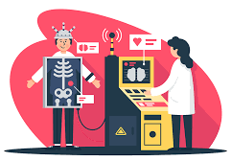
Proposed System
Using CNN model predict the x-ray report diseases weather covid positive or negative.
It gives the probability or chances of x-ray report being positive or negative and then predicts accordingly.
X-ray is examined using computer.
No manual checking.
Fast And Easy process.
Higher Accuracy .
Very less cost.

Slide 12
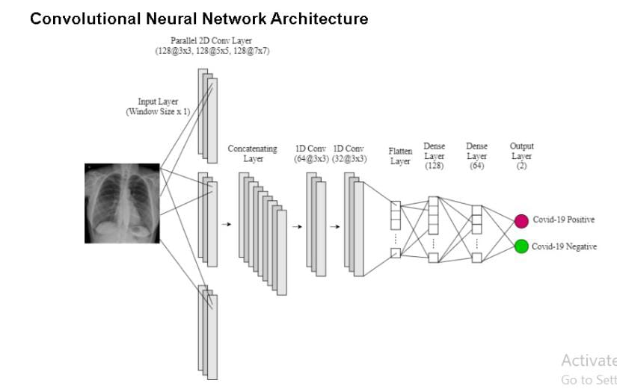
Design Of System

Slide 13
Software/Hardware Requirements
Memory and disk space required per user: 1GB RAM + 1GB of disk + . 5 CPU core.
Server overhead: 2-4GB or 10% system overhead (whatever is larger), . 5 CPU cores, 10GB disk space.
Port requirements: Port 8000 plus 5 unique, random ports per notebook.
Modern Operating System: Windows 7 or 10. Mac OS X 10.11 or higher, 64-bit. Linux: RHEL 6/7, 64-bit (almost all libraries also work in Ubuntu
Jupyter Notebook
Python 3

Slide 14
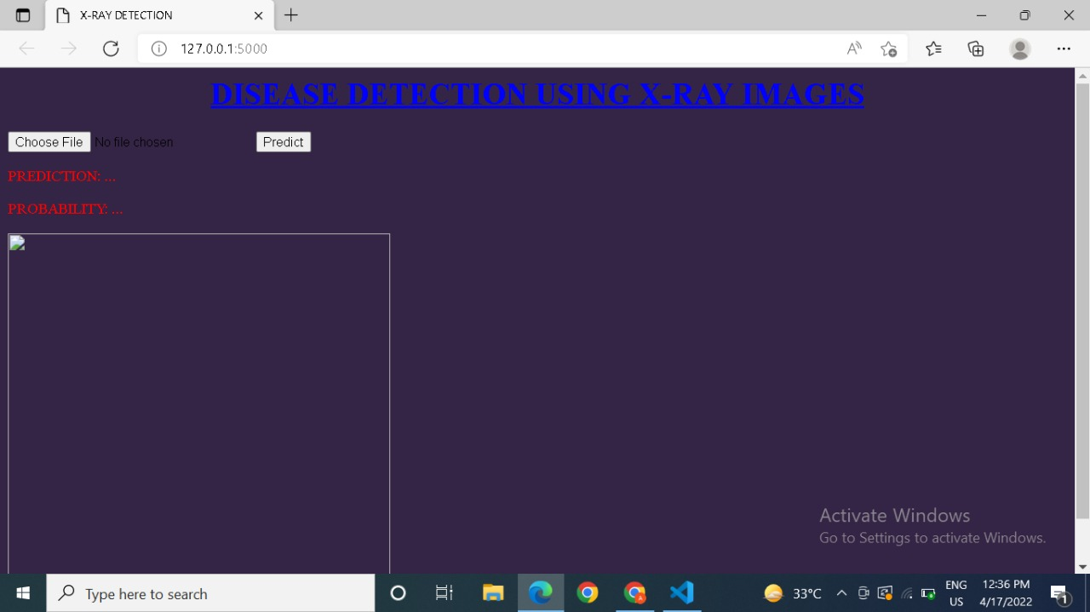
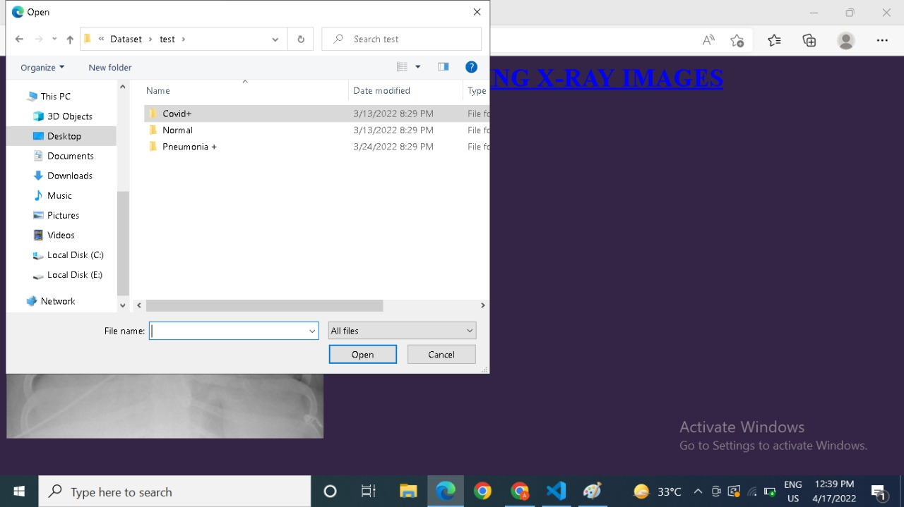
Results

Slide 15
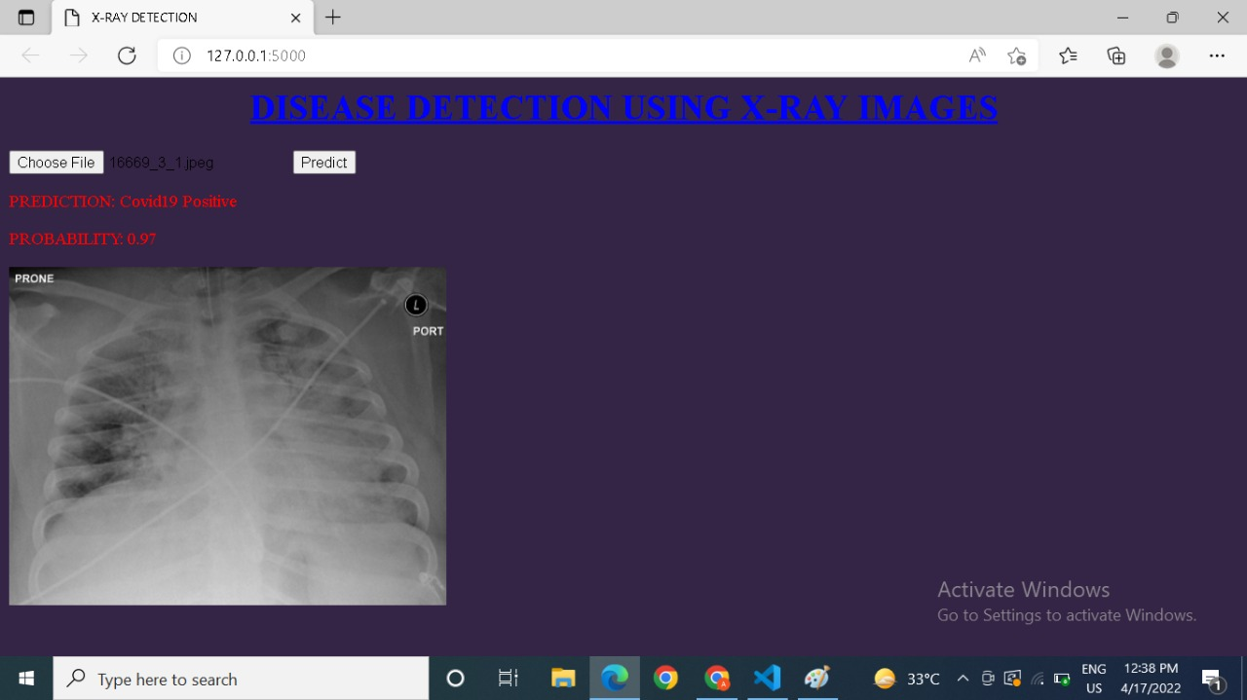
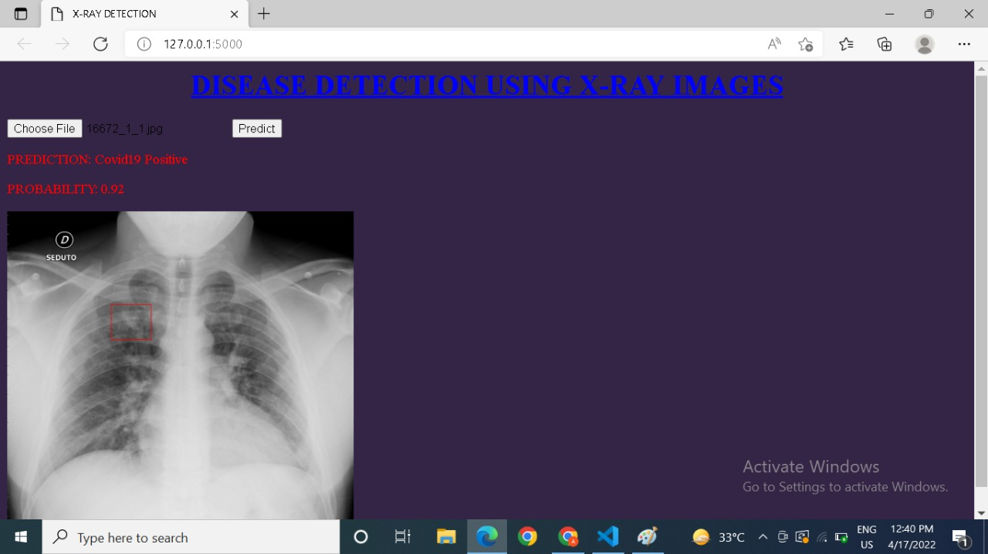

Slide 16
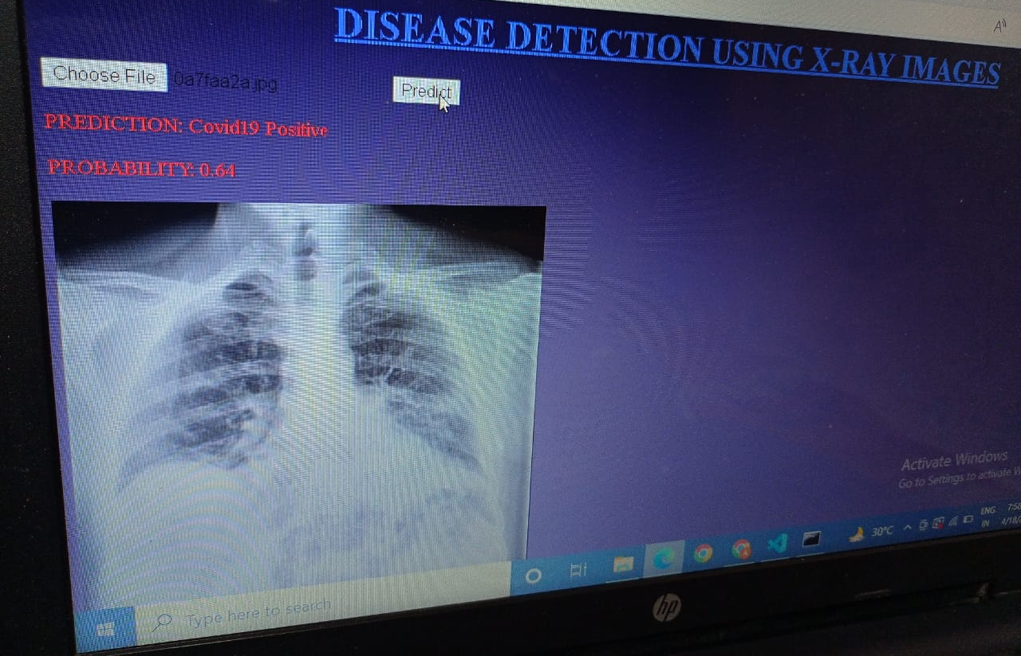

Slide 17
Conclusion
The developed CNN model will provide good accuracy on less number of layers and less number of epochs in comparison to pre-trained models.
This CNN model will be better than other models as it is less complex than others and achieving good accuracy on training, validation as well as on test dataset.
The friendly frontend UI using website will help user to easily diagnose the X-ray image and predict if user is diagnosed with Covid-19 or Pneumonia.

Slide 18
Future Scope
More user friendly User Interface
Adding more classification diseases
Using Grad Cam to properly visualize x-ray and differentiate features on part of diseases
Connecting the system with user email and nearby hospital for better health treatment and getting notified digitally
Using input x ray images for training models for improving accuracy
More algorithm can be used to give wider views of cause and reasons.

Slide 19
Reference
https://www.sciencedirect.com/science/article/pii/S2666827021000694
https://journals.plos.org/plosone/article?id=10.1371/journal.pone.0256630
https://ieeexplore.ieee.org/document/9395851
https://link.springer.com/article/10.1007/s10044-021-00970-4

Slide 20
Open
Discussion
OPEN DISCUSSION

Slide 21
Thank You
l

